Slide 1
Addressing challenges towards the deployment of higher automation

Slide 2
Addressing challenges towards the deployment of higher automation

Slide 3
Addressing challenges towards the deployment of higher automation

Slide 4
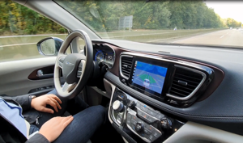
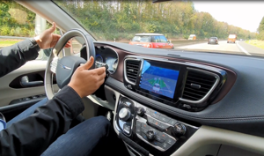
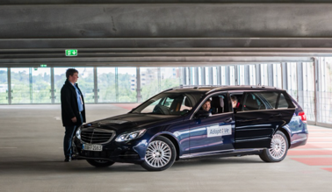
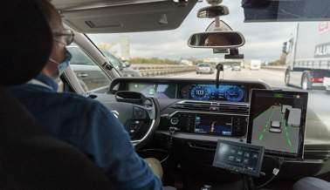
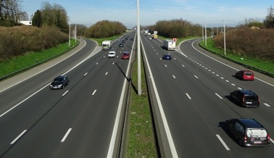
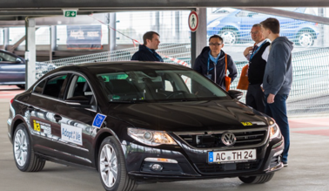
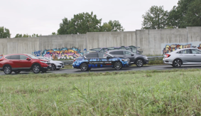
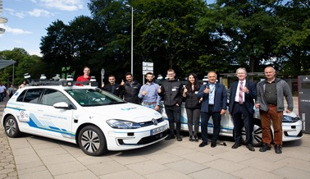
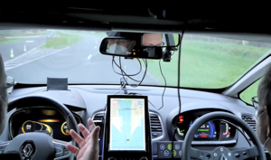
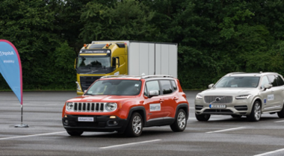
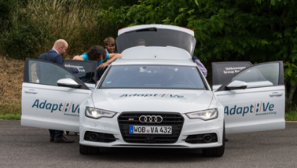
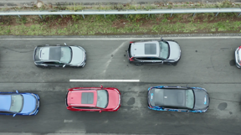
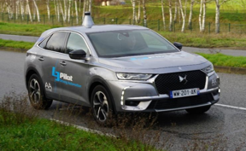
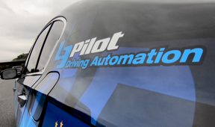
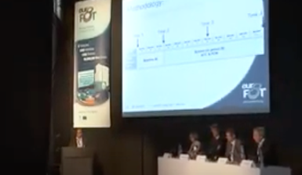
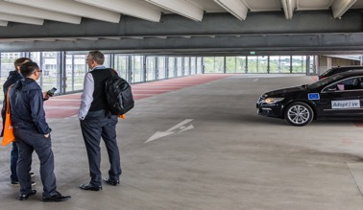
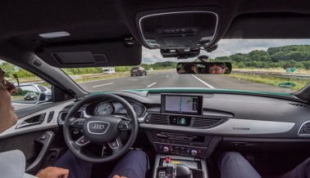
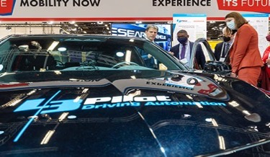
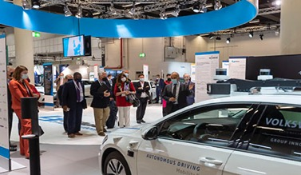
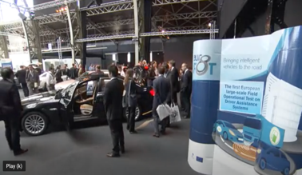
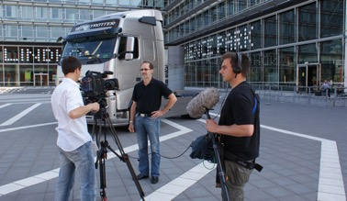
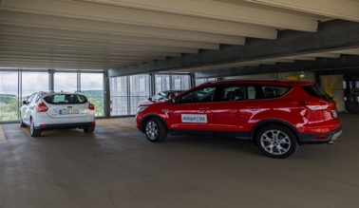
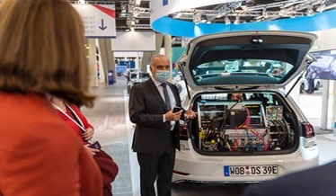
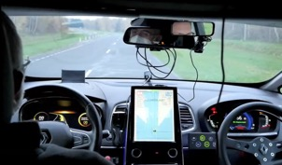
Our history of automated driving – long lasting successful collaborations
Complexity
Time

Slide 5
Challenges: technology
Complexity SAE J3016
Full
Infra support (ISAD level)
Connectivity
High
Hi-Drive
L3Pilot and SoA
digital (B) coop. perception
Tele-Operated Driving (ToD)
Conditional
V2X, V2N
digital (C) dynamic info
physical (D) static map
Partial
positioning
physical (E) no support
V2V, V2I
designated
areas
proving
ground
TEN-T
corridors
Scenarios
Testing
complex
mixed-autonomy
mixed
traffic
trails
system
testing
selected public roads
threat analysis
data sharing framework
risk asses. & recommend.
system
classification
Glossary AD
Common data format (CDF) Consolidated database (CDB)
SOTIF concept loops
Code of Practice
(CoP)
AI/ML, Big data
holistic approach cybersecurity
Edge-Case & Scenario database
series of CoPs, DIN/SAE Spec
Safety & Security
EU-harmonized CAD
vehicle admission
Data & digital technologies
De facto standards

Slide 6
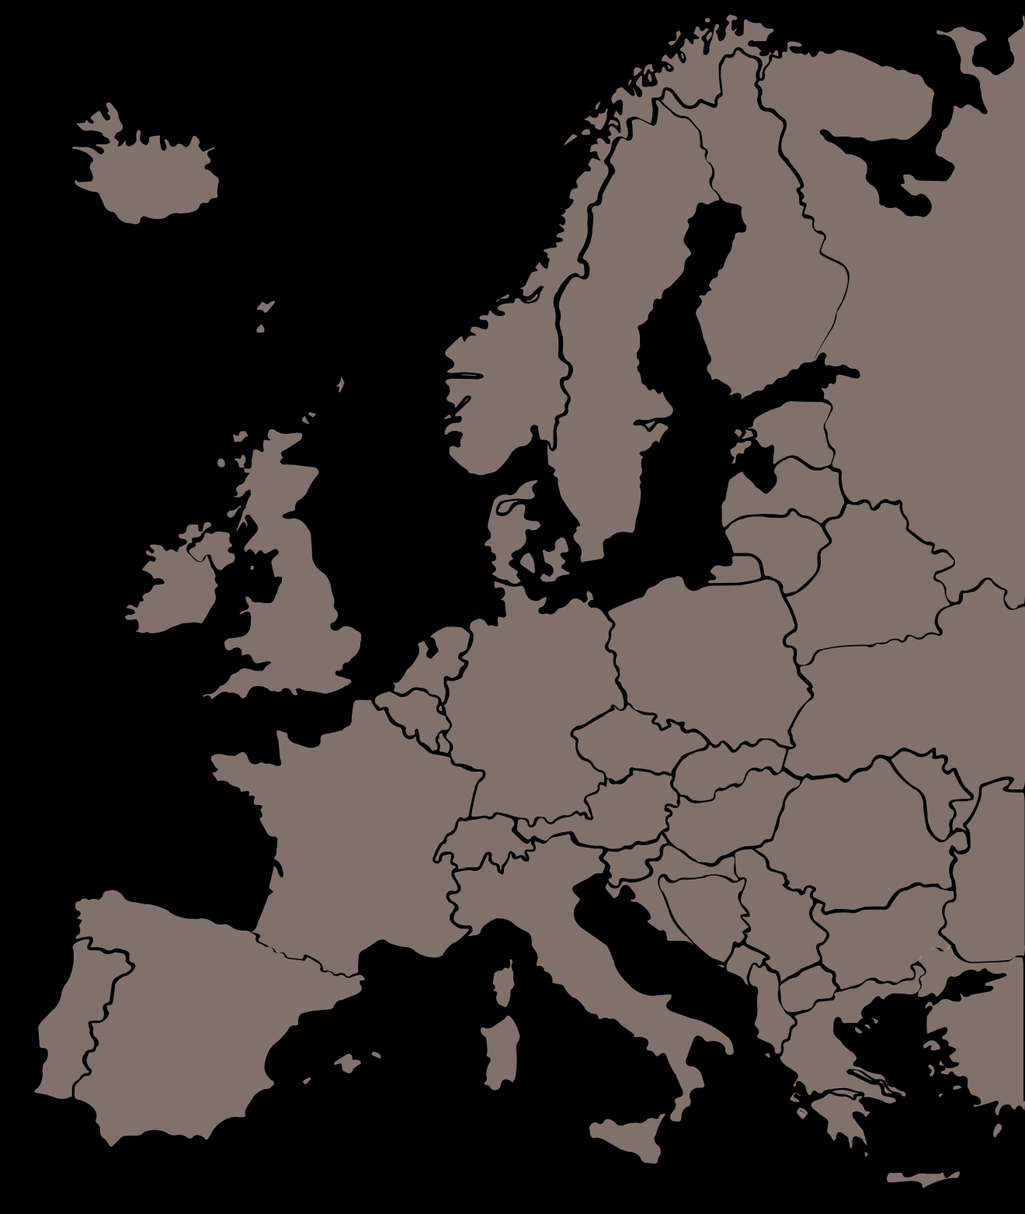
© Volkswagen
Push towards
higher automation
Robust and reliable automated driving
Extended and defragmented ODDs
Interoperability across countries and brands

Slide 7
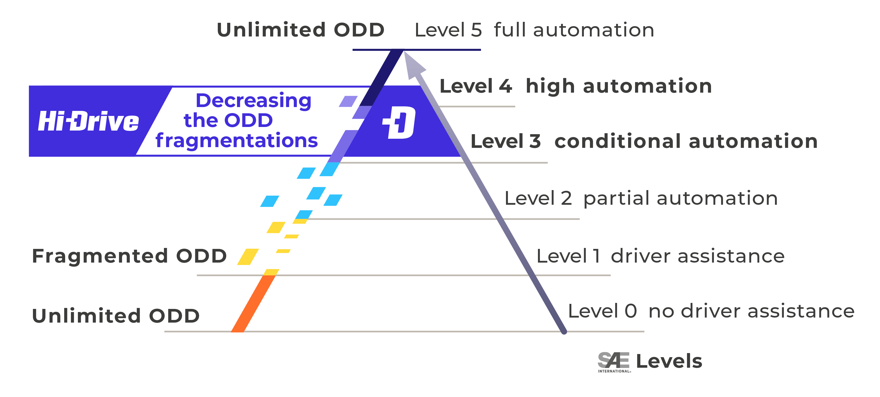
Operational Design Domain – ODD
ODD - “Operating conditions under which a given driving automation system […] is specifically designed to function […] to environmental, geographical, and time-of-day restrictions, and/or the requisite presence or absence of certain traffic or roadway characteristics.” *
*SAE J3016 (2021)

Slide 8
Operational Design Domain – ODD

Slide 9
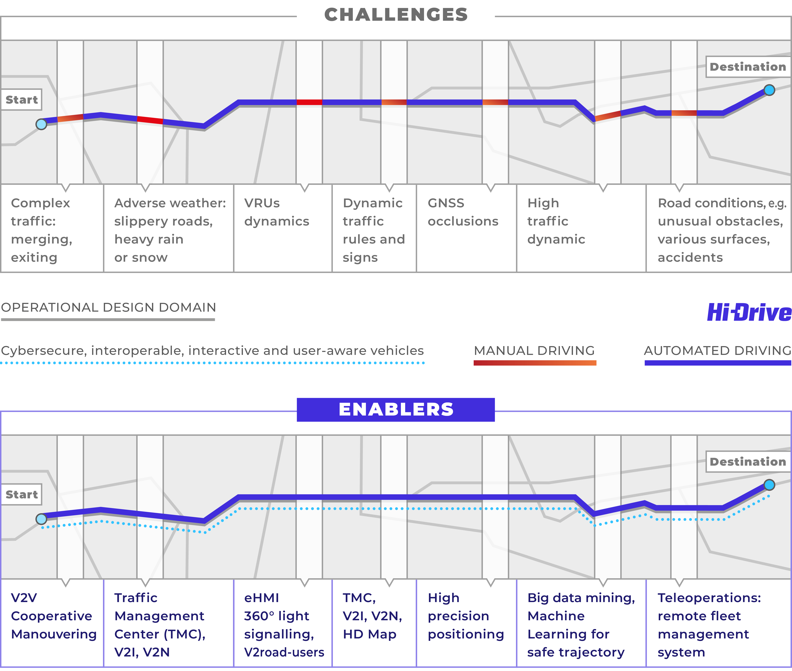
Defragmentation of Operational Design Domain
Enabling via
Resilience to cyber threats
Interoperability: vehicles of different brands, including trucks, communicating V2V; cooperative sensing and manoeuvring
Interactive vehicles: AVs communicating and interacting with vulnerable road users (V2P, VRU).
AV’s HMI: Monitoring supports driver’s / operator’s situational awareness.
TMC = Traffic Management Center
Extended field of view: AV receiving information (V2I, HD maps) to adapt to traffic beyond the line of sight.
Precise localization: vehicle positioning system to eliminate GNSS blackspots.
Use of disruptive technologies such as Big Data, IoT, Machine Learning (ML) and Teleoperation systems for seamless functioning in demanding travel conditions: complex traffic scenarios and weather conditions.

Slide 10
Defragmentation of Operational Design Domain

Slide 12
Timeline
2021
2022
2023
2024
2025
M18
M24
M36
M46
M48
Kick-off
Implementation
of enablers into vehicles
Vehicles ready
for operations
Operations and related user studies completed
Evaluations
completed
Evaluation methods
in place
Data evaluated
Showcase
Showcase
Final Event

Slide 13
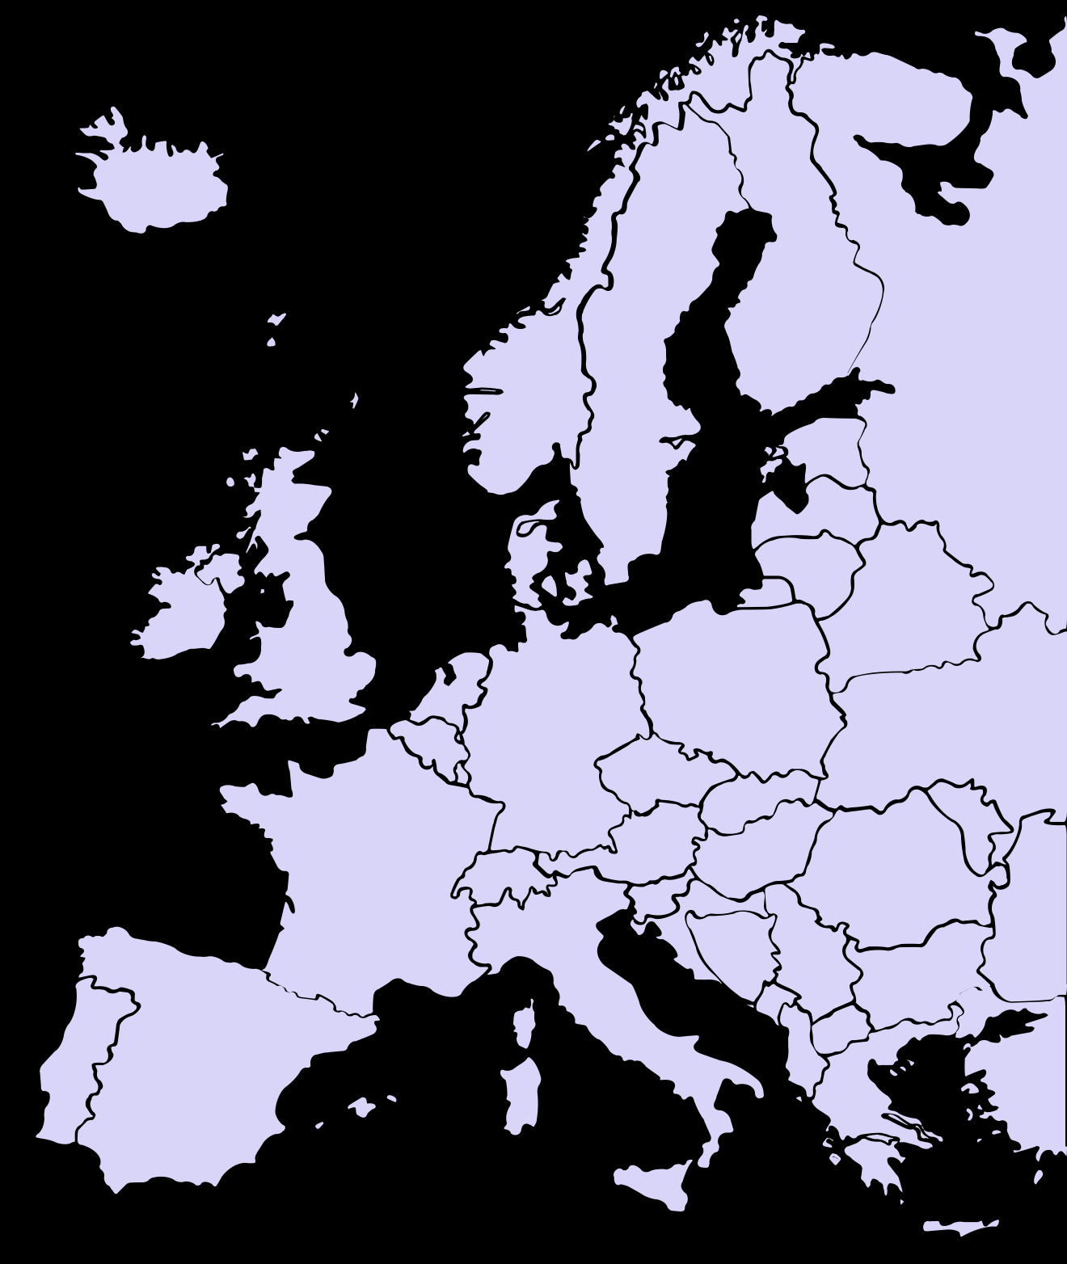
Project Facts
€60 MILLION BUDGET
€30 MILLION FUNDING
48 MONTHS DURATION starting in July 2021
40 PARTNERS among them OEMs, automotive suppliers, research institutes, associations, traffic engineering, deployment organisations and mobility clubs
14 COUNTRIES involved: Belgium, France, Finland, Germany, Greece, Hungary, Italy, Israel, Netherlands, Norway, Spain, Sweden, Switzerland, United Kingdom
Supported by the European Council for Automotive R&D
This project has received funding from the European Union’s Horizon 2020 research and innovation programme under grant agreement No 101006664

Slide 14
Partners

Slide 15
© Adobe
Technology enablers for
CAD vehicles to operate in defragmented ODDs
Extend and Defragment ODDs
Enablers Cards and KPIs
Connectivity & Digital Infrastructure
High Precision Positioning
Resilience to Cyber threats
Machine Learning for ADs

Slide 16
Objectives
Work on robust and resilient CAD systems and on CAD cooperative situation awareness: networking among vehicles, other road actors, digital road infrastructure and backbone services.
Address ODDs edge cases, where vehicle sensors cannot detect the driving situation and a take-over request is needed.
Address V2X communication white spots by using hybrid and technology neutral communication for enabling robust V2X – V2V, V2I, V2P/VRUs, V2N – for CAD functions.
Address the quality of data: their content, accessibility and trustworthiness.
Achieve resilience to cyberthreats.

Slide 17
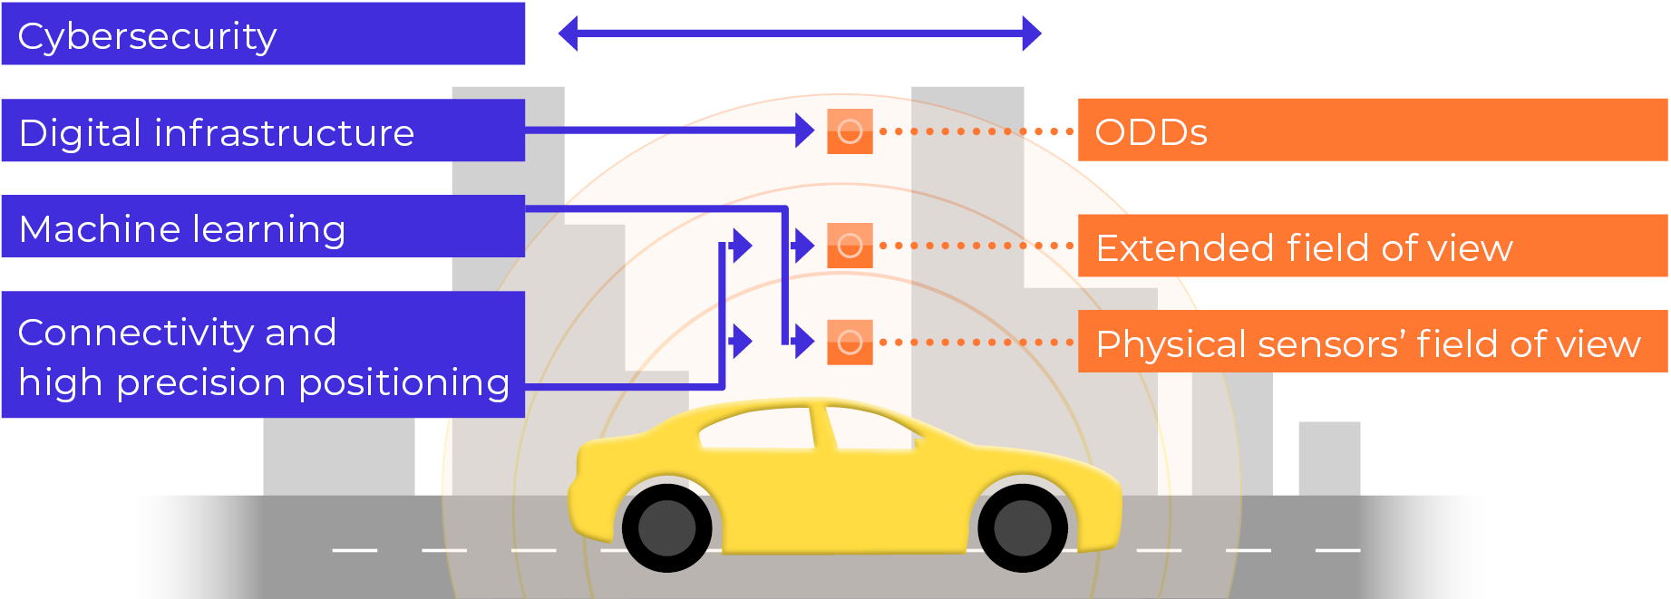
Hi-Drive CAD vehicle functions digital shell

Slide 18
Cooperative situation awareness concept

Slide 19
© EICT
Define and build up high automation fleet - passenger cars and trucks.
Use Cases & Scenarios
Logging Tools
CADFs with Enablers
Setting up the Testing & Demo System
Vehicles Preparation & Pre-testing

Slide 20
Objectives
Assess the current technological capabilities of the vehicles and integrate CAD enablers to answer the research questions.
Define a set of use cases based on the identified vehicles functions and capabilities, including the description of the AD function, the enablers and their ODDs.
Carry out pre-tests to ensure the end-to-end process works in preparation for the main test operations in SP Operations.

Slide 21
Integrate CAD enablers to answer the research questions

Slide 22
© Unsplash
Extended methodology for testing high automation across Europe – from single user and vehicle level to transport system level
Multidisciplinary Methodology
Research Questions & Data
Impact Mechanisms
Experimental Procedures
Evaluation Methods
Common Data Formats

Slide 23
Objectives
Specify research questions and how they will be addressed across Hi-Drive:
For all enablers, automated driving functions and use cases of high-level automation.
For both users and effects evaluation, and related data needs.
Agree on common data formats for provision of different datasets and on experimental procedures for testing and evaluating highly automated systems.
Build a multidisciplinary evaluation methodology and refine state-of-the-art methods:
To address user and human factors aspects.
To facilitate understanding of possible effects on the transport system level, addressing travel behaviour, safety, efficiency and emissions.

Slide 24
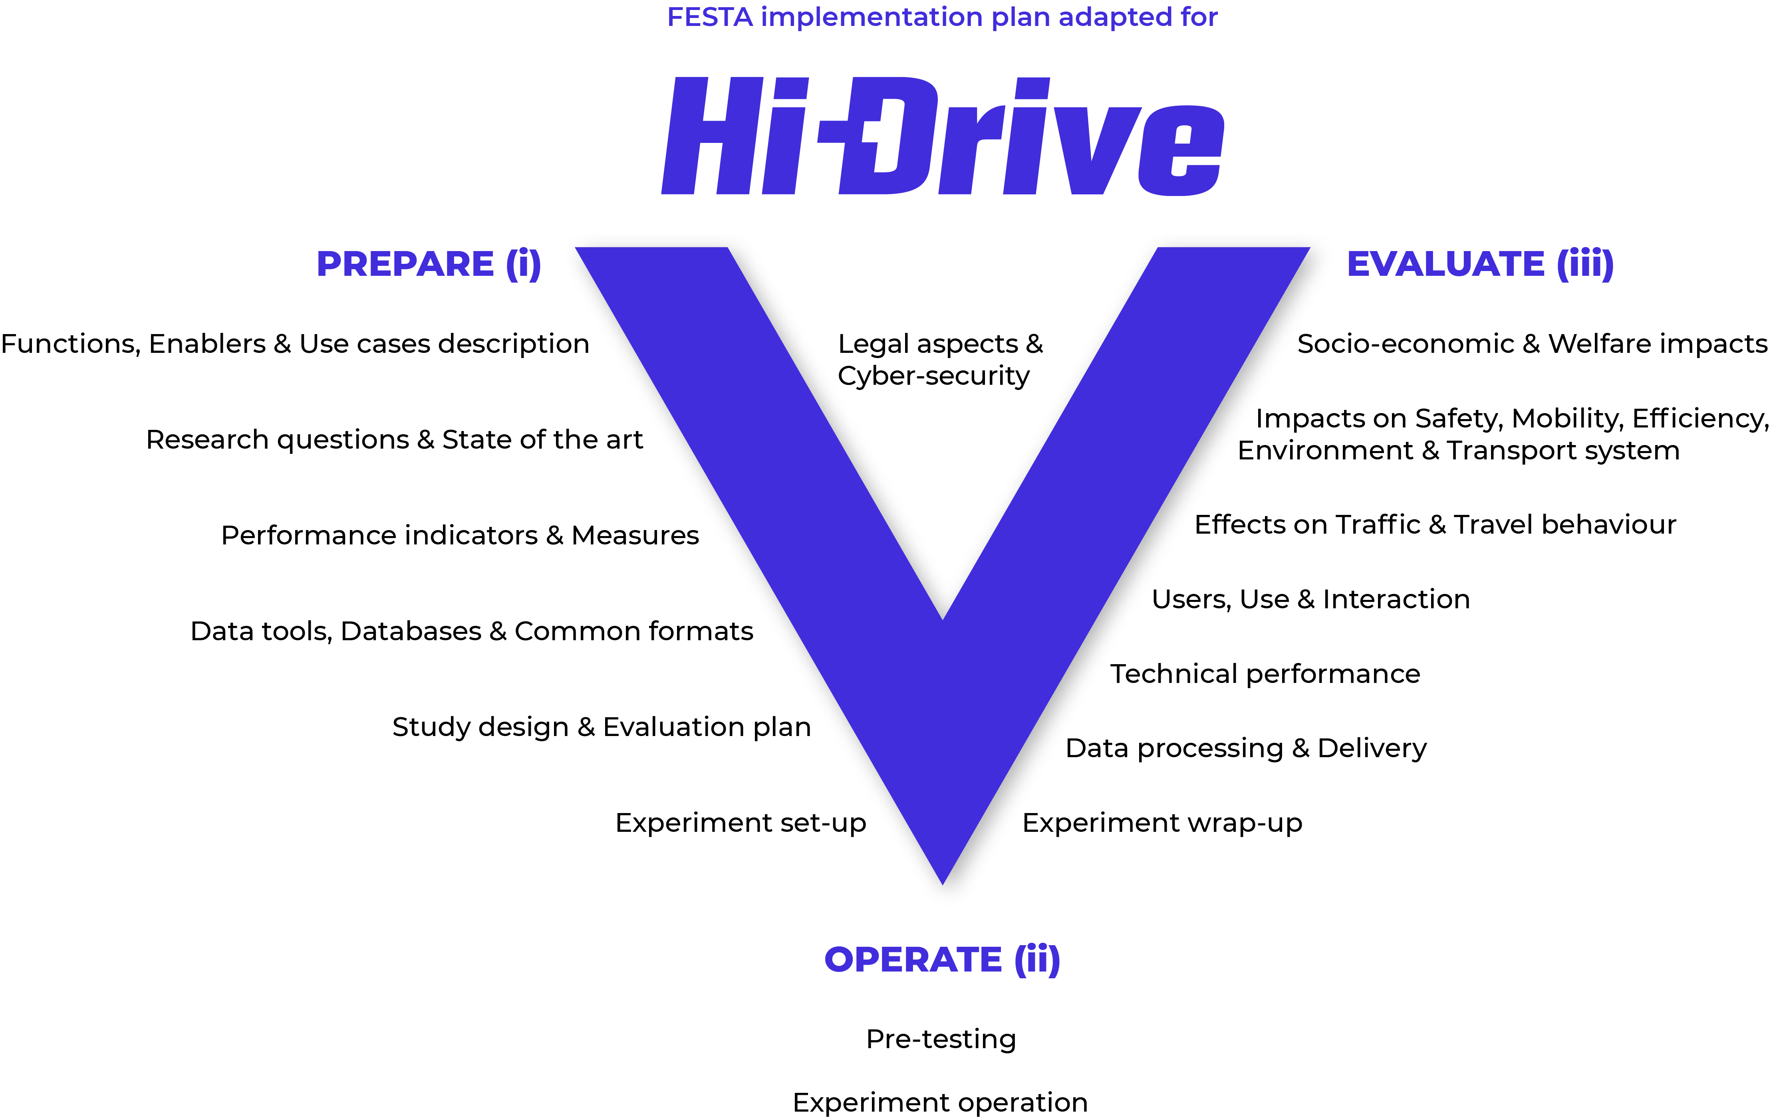
FESTA

Slide 25
© Volkswagen
Testing performance and reliability of ADFs for extending and defragmenting ODDs
Trials on Public Roads
Cross-border Corridors Testing
Test Tracks and Simulations
Data Engineering Tools
Data Collection
Common Databases (CDB)
Showcases and Demonstrations

Slide 26
Objectives
On open roads, on tracks and supported by simulation focus on:
Technologies for CAD systems such as connectivity – V2V and V2I –, accurate positioning, digital infrastructure and cybersecurity
Challenging situations like cross-border corridors, edge and critical driving scenarios, and arctic low visibility conditions
Design data engineering tools and database structures to manage and process data from the experiments.
Collect data during the tests and make this data available.
Each vehicle owner covers specific enablers, vehicles, use cases, test environments and partnerships.

Slide 27
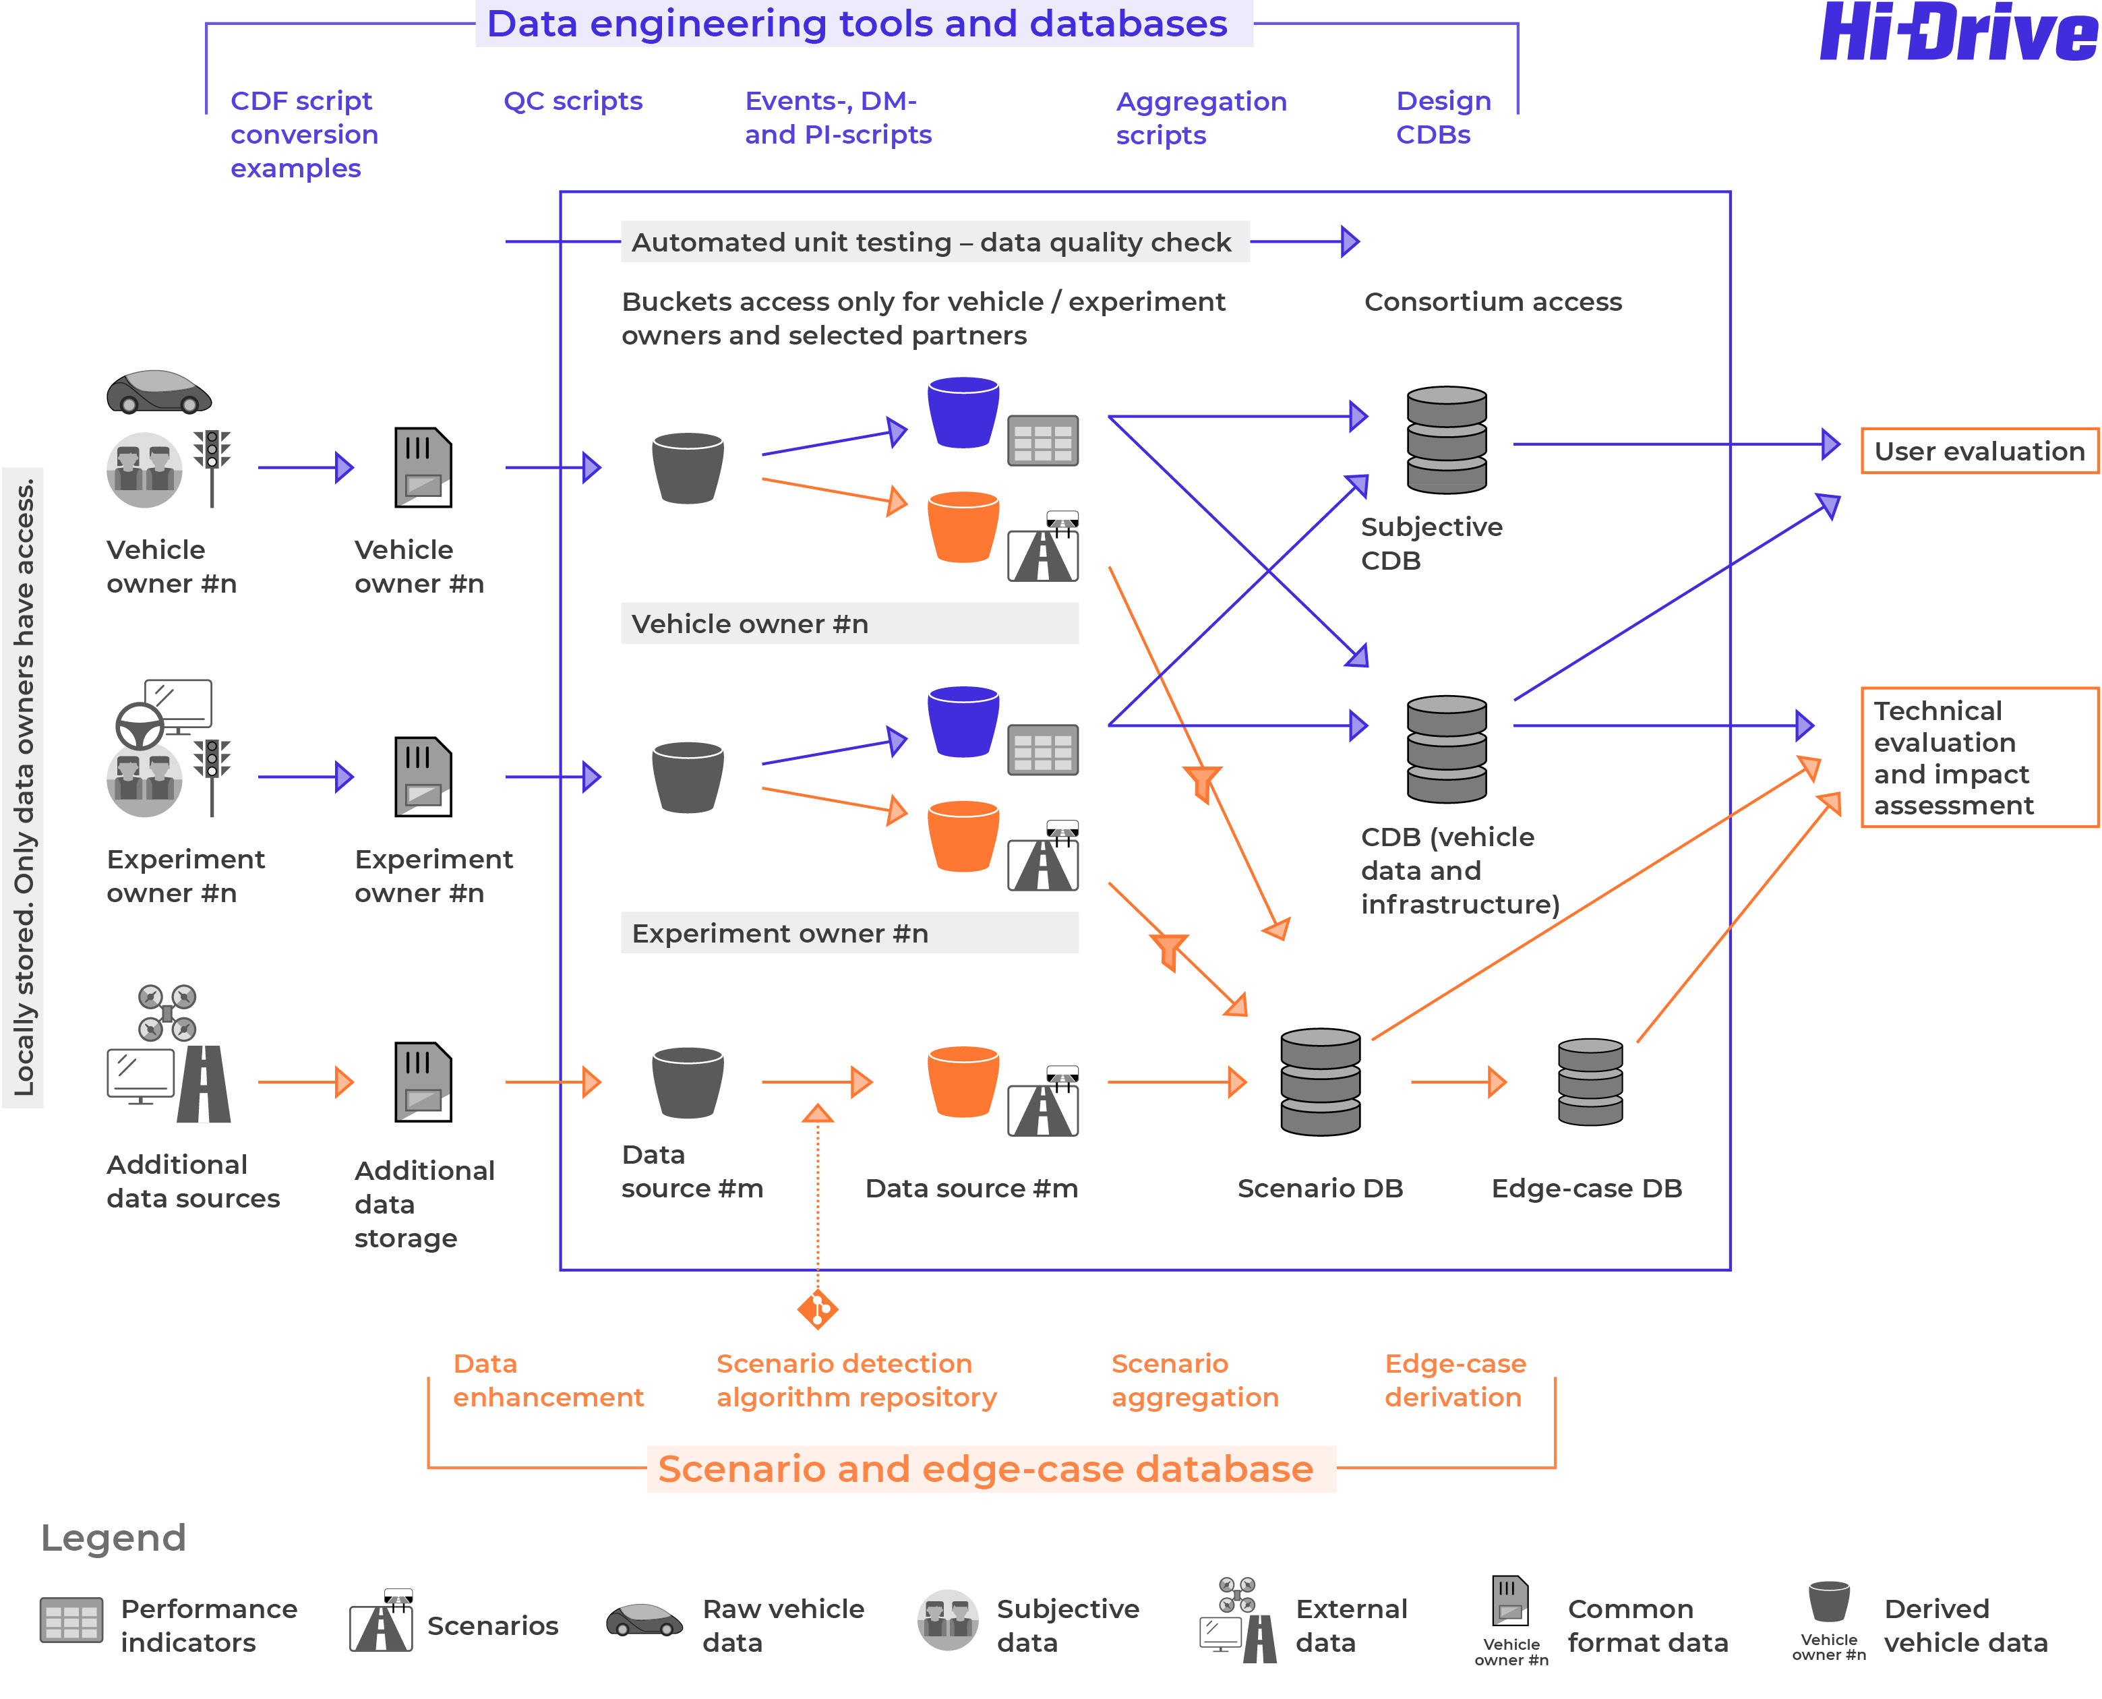
Data Process

Slide 28
© Adobe
Develop a firm understanding of the user when interacting with automated vehicles.
Acceptance
Awareness & Expectations
User comfort
User monitoring & HMIs
Other road users

Slide 29
Objectives
Understand and map the needs of different user groups by assessing user needs for ages, genders, cultures etc. to ensure automated vehicles are relevant for all sections of the population.
Assess what factors influence user acceptance and awareness of CAD vehicles, on a macro and micro scale.
Investigate how to evaluate and improve CAD vehicles’ comfort, and reduce motion-sickness for users.
Develop knowledge for successful application of user monitoring and intervention tools, including link to relevant Human-Machine Interfaces.
Determine what information is needed by VRUs and other road users when interacting with CAD vehicles, including teleoperation.

Slide 30
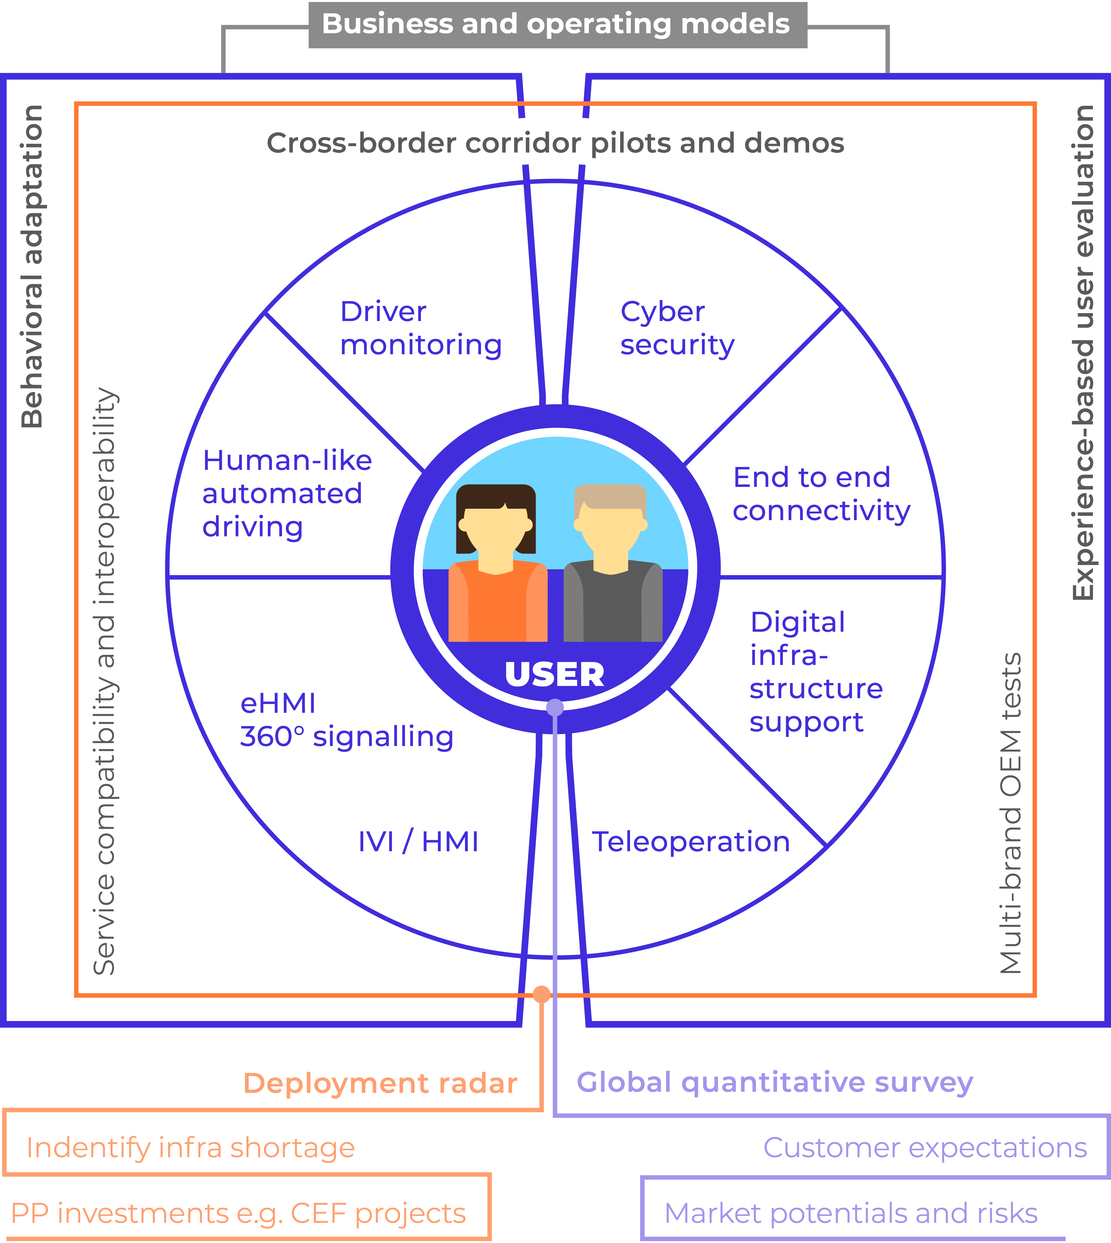
User centered

Slide 31
Conduct empirical user studies incorporating a range of tools
Global surveys, and questionnaires
Human-in-the-loop simulators
Test track studies
Wizard-of-oz vehicles

Slide 32
© Adobe
Assess the impacts of high automation up to transport system and socio-economic level.
CAD Technical Evaluation
Edge-Case and Scenario Database
Micro- and Macroscopic Simulations
Safety & Security
Traffic efficiency & Environment
Mobility & Travel Behaviour
Socio Economic Effects

Slide 33
Objectives
Collect scenarios and extract edge cases from data and generate test-cases for evaluation of Hi-Drive CAD-functions.
Develop and operate a database of common scenarios and edge-case scenarios which can be utilized for uniform testing of automated driving.
Evaluate the technical performance of enablers for high-level automation with regards to their efficiency and support to automated driving as well as their capability to defragment or extend the related ODD.
Assess the impacts of high automation driving on safety, efficiency and mobility as inputs to determine the effects on the transport system and on socio-economic level.
Provide lessons learned from data evaluation on methodology and tooling for future automated driving development.

Slide 34
© Adobe
Advocate deployment of high automation in Europe and beyond.
Public Awareness
Demonstration Campaigns
Standardisation Blueprint
User Education & Training Programme
Business & Operating Models
Pipeline from Research to Deployment

Slide 35
Objectives
International visibility
Advocate deployment of high automation in Europe and beyond.
Demonstrate leading role of European research and industry in high automation.
Reach the targeted audiences at high-level events.
User acceptance
Guide user expectations and promote awareness.
Organize user education & training campaign: hands-on training curriculum at five training sites across EU.
Viable business strategies
Assess the market potential of high automation and prepare the ground for future operating models of Connected Automated Mobility (CAM) systems and solutions.
Industry standards
Map, investigate and feedback information for technology standards.
Influence international standardization activities, particularly from European perspectives.

Slide 36
Public awareness and demonstrations
2021
2022
2023
2024
2025
Virtual Roadshows & Demonstrations: Cooperative Autonomy, Inter-operability demos of multi-brand V2X, Edge Cases: snow & fog, Roundabouts 5G V2X testbed, Cybersecurity: holistic approach, 360˚ light signalling, …, etc.
Enablers
Hi-Drive enablers identified
@EUCAR Conference
Autoworld, Brussels
Testing High Automation
Hi-Drive vehicles ready
Cooperative sensing & manoeuvring
Crossing Borders
Towards compatible and interoperable systems at EU level
Final Event
Challenging & urban environments
User education and driver training campaign @11 EU Mobility Clubs

Slide 37
© Adobe
Deployment ecosystem, the collaboration platform for cross-sector alliances and strategic liaison
Roadmap Coordination
Cross-sector Alliance
Stakeholder Engagement Process
Deployment Ecosystem
Strategic Liaison and Twining
Series of CoPs

Slide 38
Objectives
Further extend the “Code of Practice for development of Automated Driving Functions”.
Develop a “Code of Practice for road tests” on EU-wide harmonized admission procedures for CAD testing on public roads.
Support European global transport governance for high level automated driving.
Arrange a systematic stakeholder engagement process and community building to enhance the exploitability of the project results and ensure the interoperability of the CAD systems.
Liaise with projects relevant to the Hi-Drive project and coordinate the international cooperation in agreement with the European Commission as well as the third country partner organisations.

Slide 39
Public Deliverables
Title | Expected | Topic
Outlook to future enabler KPIs for AD/CAD | Q1/2025 | Enablers
Use cases and ODD description | Q2/2022 | Vehicles
Logging tools recommendations | Q2/2022 | Vehicles
Description of vehicles | Q4/2022 | Vehicles
Research questions | Q4/2022 | Methodology
Data for evaluation | Q3/2022 | Methodology
Experimental procedure | Q4/2022 | Methodology
User evaluation methods | Q2/2023 | Methodology
Effects evaluation methods | Q2/2023 | Methodology

Slide 40
Public Deliverables
Title | Expected | Topic
Description of Operations | Q2/2022 | Operations
User acceptance and awareness results | Q4/2024 | Users
Human-like driving and user comfort | Q3/2025 | Users
Effects on Safety | Q3/2025 | Effects
Effects on Mobility, Efficiency and Environment | Q3/2025 | Effects
Socio-Economic Effects | Q3/2025 | Effects
Report on public awareness and demonstration campaign | Q2/2025 | Outreach
Minimum set of standards applicable to Hi-Drive | Q1/2022 | Outreach
Hi-Drive standardization contributions | Q4/2024 | Outreach

Slide 41
Public Deliverables
Title | Expected | Topic
Information toolkit for social media campaign and curriculum for driver training | Q1/2023 | Outreach
Code of Practice for the Development of Automated Driving Functions | Q2/2025 | Collaborations
Code of Practice for road testing | Q2/2025 | Collaborations
Final Project Results | Q3/2025 | Collaborations

